Slide 1
Chapter 5.1 Code Tuning Strategies and Techniques
CCSW 325 (Software Construction)
Notes:
Last Update: 22/8/2019
Version 1.0

Slide 2
Outline
Introduction to Code Tuning
Code Tuning Strategies and Techniques

Slide 3

Introduction to Code Tuning
Code tuning is one way of improving a program’s performance.
Modifying correct code to make it run more efficiently.
20% of a program’s methods consume 80% of its execution time.

Slide 4
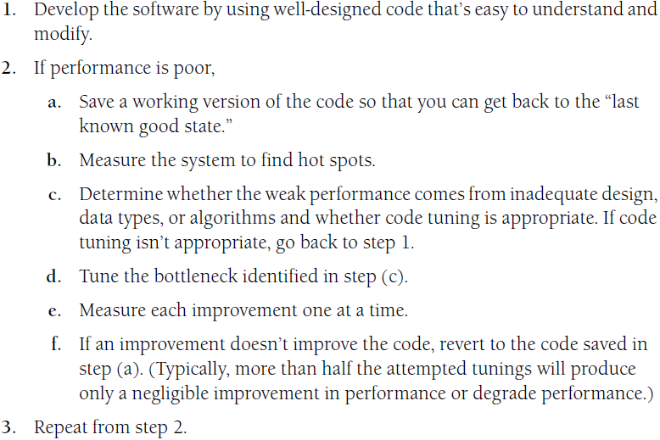
Introduction to Code Tuning
Summary of the approach to code tuning:

Slide 5

Code Tuning Strategies and Techniques
Logic
Loops
Data Transformations
Expressions

Slide 6

Logic
Much of programming consists of manipulating logic.
This section describes how to manipulate logical expressions to your advantage.

Slide 7
Logic
Stop Testing When You Know the Answer
Suppose you have a statement like
Once you’ve determined that x is not greater than 5, you don’t need to perform the second half of the test.

Slide 8

Logic
If your language doesn’t support short-circuit evaluation natively, you have to avoid using and and or, adding logic instead.
With short- circuit evaluation, the code above changes to this:
Notes:
# Short-circuit evaluation in Python
number = 3
if number > 5 and number < 10:
print("Number is both greater than 5 and less than 10.")
else: print("Number does not satisfy both conditions.")
In this case, with the number being 3, Python (which supports short-circuit evaluation) will output: "Number does not satisfy both conditions." The second condition (number < 10) is not checked because the first condition fails, and the evaluation stops due to short-circuit behavior.

Slide 9

Logic
The principle of not testing after you know the answer is a good one for many other kinds of cases as well.
A search loop is a common case
If you’re scanning an array of input numbers for a negative value and you simply need to know whether a negative value is present, one approach is to check every value, setting a negative Found variable when you find one.
Notes:
refers to the efficiency gained by ceasing to evaluate or perform further acIn programming, this principle emphasizes that when a logical condition has been met (for instance, a condition in an "if" statement), there's no need to continue evaluating subsequent conditions because the final outcome is already determined. tions once the desired or conclusive result has been attained or determined.

Slide 10
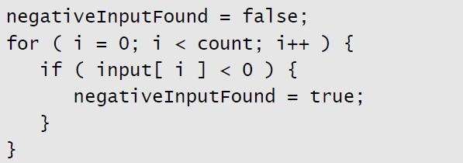
Logic
A better approach would be to stop scanning as soon as you find a negative value. Any of these approaches would solve the problem:
Add a break statement after the negativeInputFound = true line.
If your language doesn’t have break, emulate a break with a goto that goes to the first statement after the loop.
Change the for loop to a while loop, and check for negativeInputFound as well as for incrementing the loop counter past count.

Slide 11
Logic
Order Tests by Frequency
Arrange tests so that the one that’s fastest and most likely to be true is performed first.
This principle applies to case statements and to chains of if-then-elses.

Slide 12
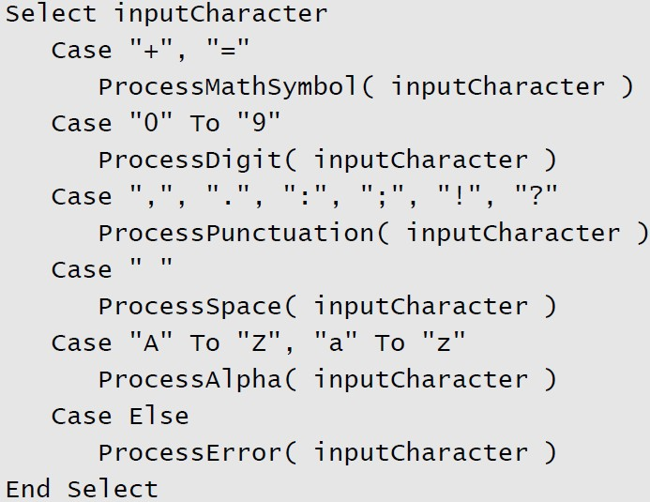
Logic
Here’s a Visual Basic Select-Case statement that responds to keyboard input in a word processor

Slide 13
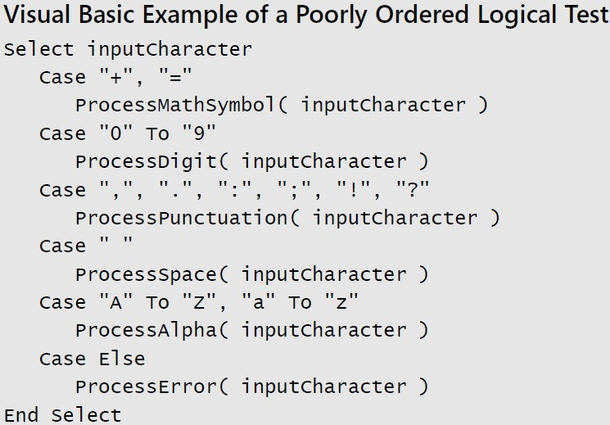
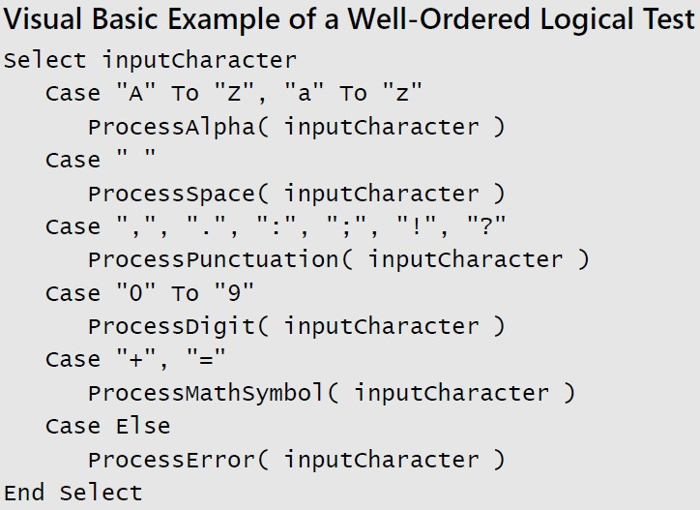
Logic
The cases in this case statement are ordered in something close to the ASCII sort order
Here’s the reordered case statement:

Slide 14
Assertions: Guidelines for Using Assertions
Because loops are executed many times, the hot spots in a program are often inside loops.
The techniques in this section make the loop itself faster.

Slide 15
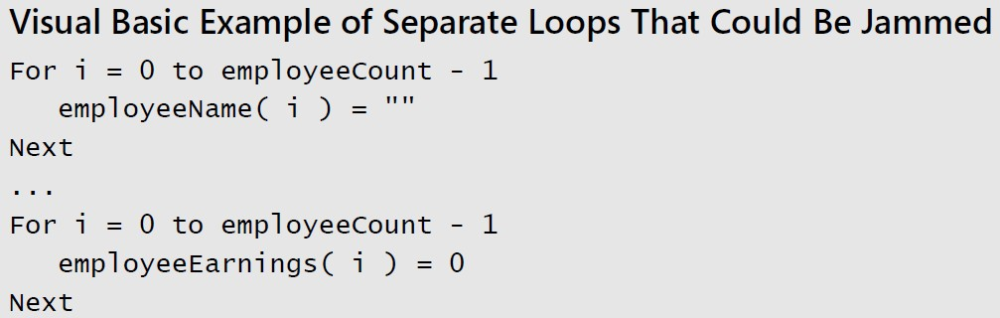
Loops
Jamming
Jamming, or “fusion”, is the result of combining two loops that operate on the same set of elements. The gain lies in cutting the loop overhead from two loops to one.
Here’s a candidate for loop jamming:

Slide 16
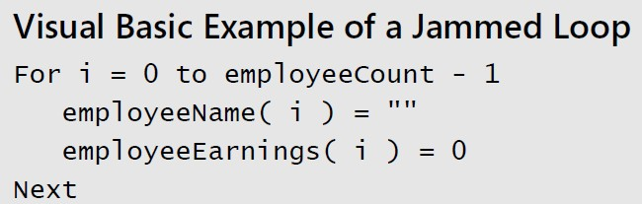
Loops
When you jam loops, you find code in two loops that you can combine into one.
Usually, that means the loop counters have to be the same. In this example, both loops run from 0 to employeeCount - 1, so you can jam them:

Slide 17
Loops
Minimizing the Work Inside Loops
One key to writing effective loops is to minimize the work done inside a loop.
If you can evaluate a statement or part of a statement outside a loop so that only the result is used inside the loop, do so.
It’s good programming practice, and in some cases it improves readability.

Slide 18
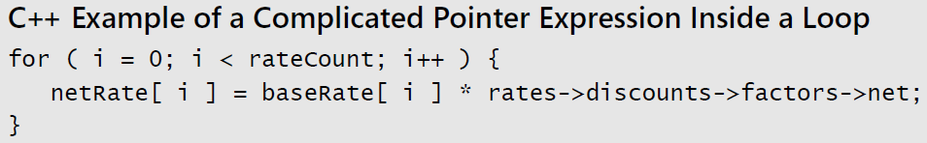
Loops
Suppose you have a complicated pointer expression inside a loop:

Slide 19
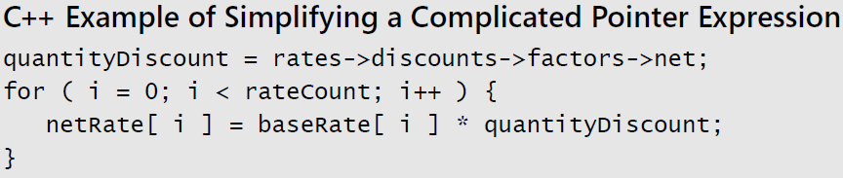
Loops
In this case, assigning the complicated pointer expression to a well- named variable improves readability and often improves performance.

Slide 20
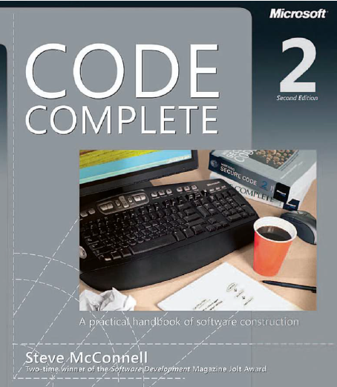
Reading
Code Complete: A Practical Handbook of Software Construction, 2nd Edition, Steve McConnell.
Chapter 26

Slide 21


Slide 22

Any questions? ​
Please feel free to raise your hands and ask.

